Slide 1
DATA ANALYSIS
An analysis on data collected from a survey conducted on over 4000 Farmers

Slide 2
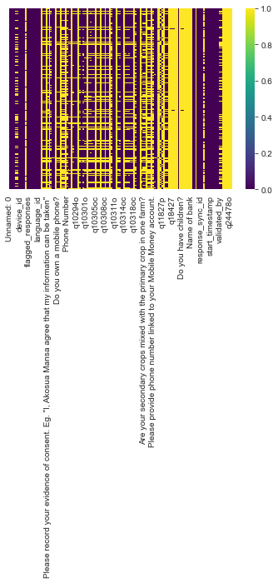
Data Cleaning
Data set had a significant number of null values .
Some columns had 100% of it values null.

Slide 3
Data Cleaning
To prevent discarding relevant data and also avoid bias and invalid conclusions, columns with over 30% null values were dropped, with only one exception.
A column with at least 30% null values implies 70% complete values , and it is relatively safe to make conclusions based on 70% of the observations.
Columns like ’sales_point_name’ had 75% of it cells null and “Which animal do you rear” column had 58% null values.
An exception was made to “Name of farmer Group” had 43% null values, to preserve relevant data.
In addition columns with less relevant data were also discarded . Example “device_id”.

Slide 4
Data Cleaning
Numerical columns with null values were filled with mean values of the respective columns. For instance columns like Age , Years of farming experience, Household size ,etc.
Categorical columns like Gender and Marital status, had codes corresponding to various data values .
Categorical columns were grouped by( or according to) corresponding coded columns.

Slide 5
Data Cleaning
For categorical columns with null values , empty cells were filled with by mode imputation method . That is, for each categorical column, the null values were filled with the categorical value with the highest number of occurrence.

Slide 6
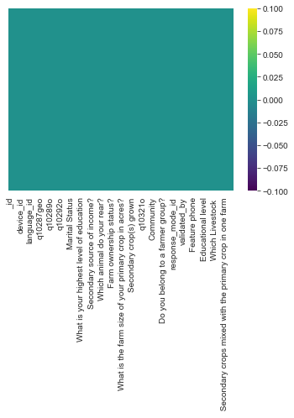
Data Cleaning
After data cleaning, there were no null values present.

Slide 7
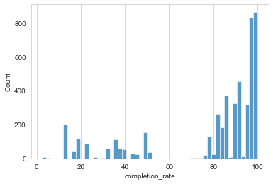
Findings
Completion_ rate
This shows rate of completion of questionnaires by respondents (Farmer).
This and others, assess the accuracy of the survey in general.

Slide 8
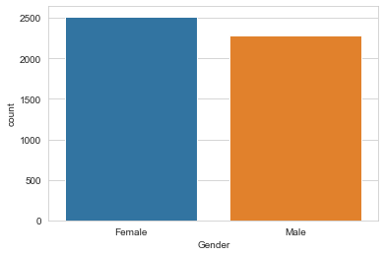
Findings
Graph of Gender
There are more female farmers than male farmers.

Slide 9
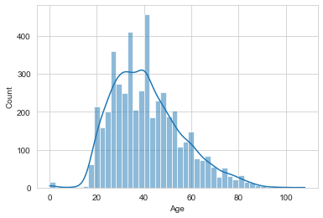
Findings
Distribution of Ages of Farmers.
The average age range of the farmers are 20 to 60 years.

Slide 10
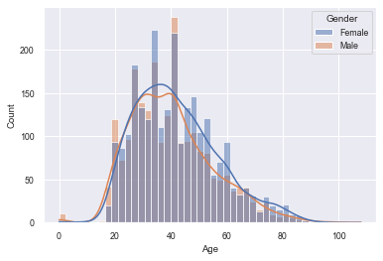
Findings
This shows the composition of Age with respect to Gender.

Slide 11
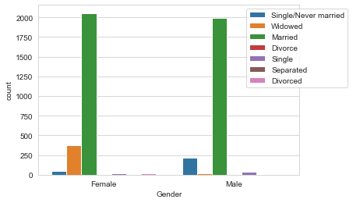
Findings
Gender with respect to Marital status

Slide 12
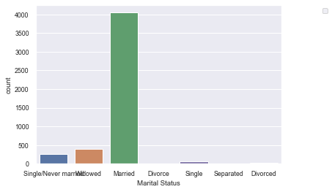
Findings
Marital Status
Gender with respect to marital status

Slide 13
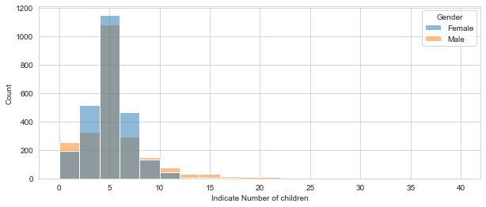
Findings
Number of children of farmers with respect to gender
Most of the farmers have 5 children.
The female farmers are the most with 5 children compared to 1the male farmers.

Slide 14
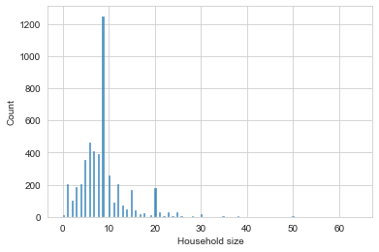
Findings
Household size of farmers
Over 1200 of the farmers have household sizes nearer to 10.

Slide 15
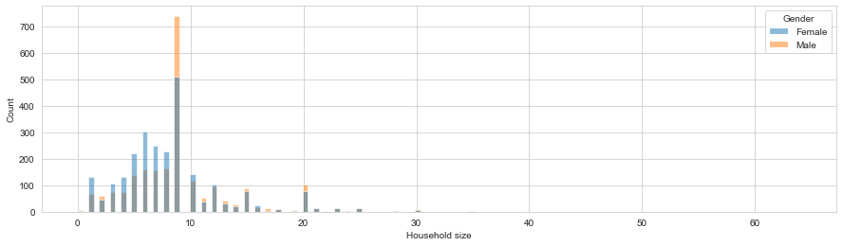
Findings
Household size with respect to gender.

Slide 16
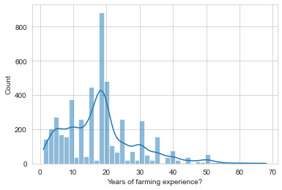
Findings
Years of farming experience
Most of the farmers have 18 years of farming experience

Slide 17
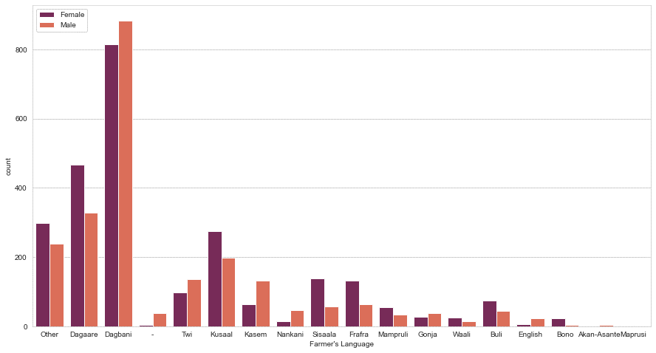
Findings
Farmer’s Language with respect to Gender.
Dagbani is the most spoken language among the farmers , followed by Dagaree.
More male Farmers speak Dagbani more than the female farmers.
More female farmers speak Dagaree than the male farmers.

Slide 18
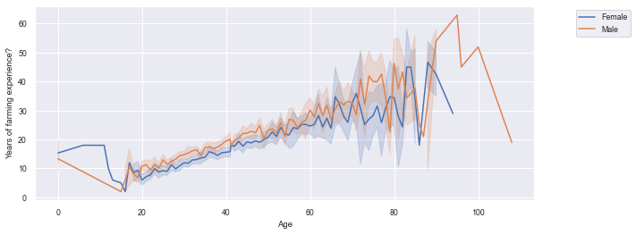
Findings
Graph of Age and years of experience.
As the ages of the Farmers increase the years of experience increases. This also applies in the case of Gender.

Slide 19
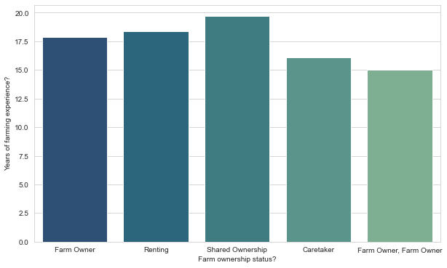
Findings
Farmers with the highest years of farming experience share ownership of farms.
Farm owners have past 17.5years farming experience.
Farmers who are caretakers of farms have less than 17years experience

Slide 20
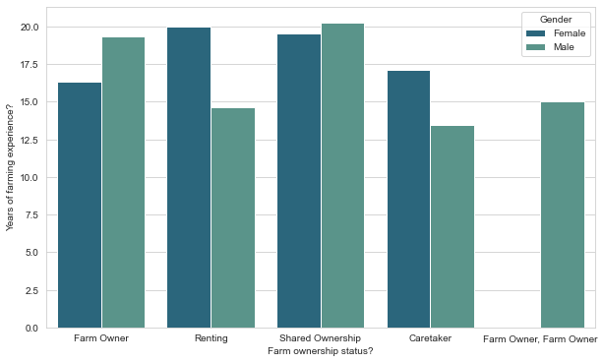
Findings
Farm ownership compared to the years of farming experience given Gender.
There are more male farm owners than female farm owners. .Female farm owners have less farming experience compared to male farmers.
Female farmers rent farms than male farmers.
Male farmers share farm ownership compared to female farmers,

Slide 21
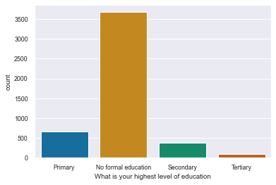
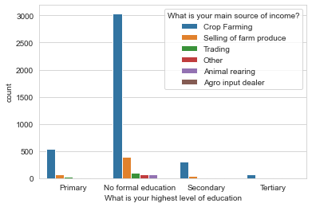
Graphs of highest level of education and highest level of education compare with main source of income.
Farmers with no formal education generate their main income from crop farming.
Most of the farmers have no formal education.

Slide 22
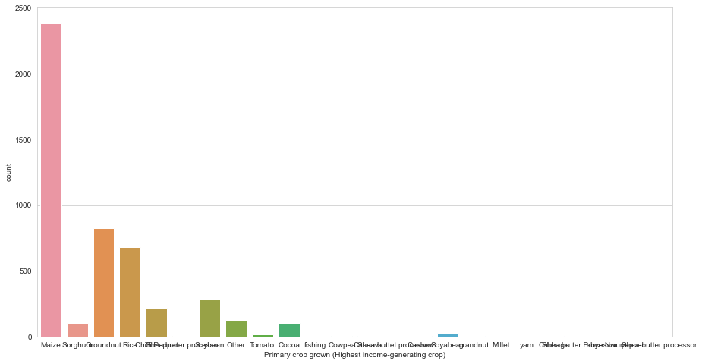
FINDINGS
Graph of highest income generating crop
Maize is the highest income generating crop ,followed by Groundnut ,Rice and Sorghum respectively.

Slide 23
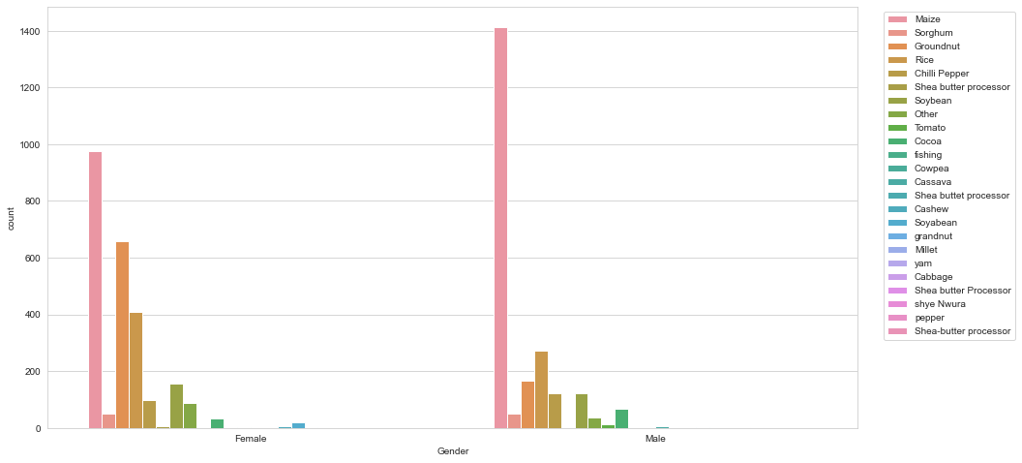
Graph of highest income generating crop with respect to Gender Apart from Maize being the highest income generating crop, Male farmers grow r1ice more than groundnut whlst the females grow more groundnut than rice

Slide 24
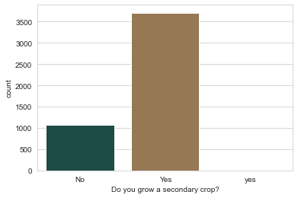
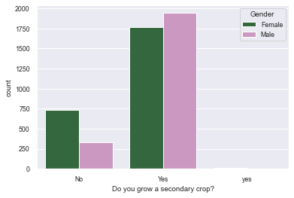
Graph of number farmers who grow secondary crops.
Number of Farmers who grow secondary crops.
Majority(over 3500) famers grow secondary crops
Gender composition of Farmers who grow secondary crops. More male farmers grow secondary crops than females

Slide 25
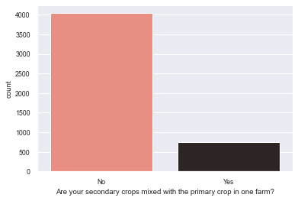
Graph of Are secondary crops mixed with the p1rimary crop in one farm?.
Majority of the farmers do not have their secondary crops mixed with the p1rimary crop in one farm.
About 800 farmers have their secondary crops mixed with the p1rimary crop in one farm.

Slide 26
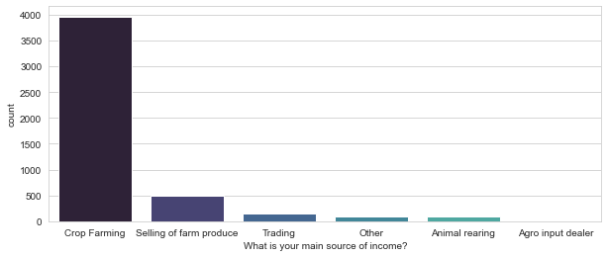
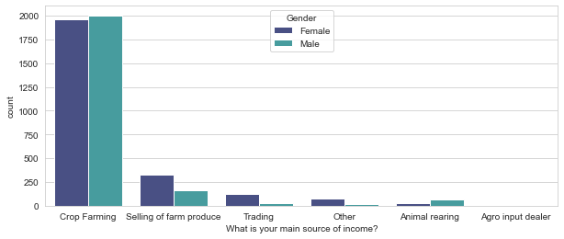
Graphs of main source of income and main source of income with respect to gender
The Main source of income for farmers are crop farming followed by selling of farm produce
Gender composition of Farmers who grow secondary crops. Males generate more income from crop farming than males. Female farmers generate more income from selling farm products than males.

Slide 27
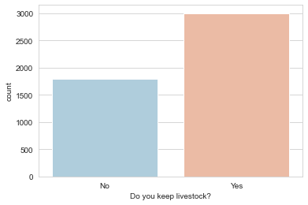
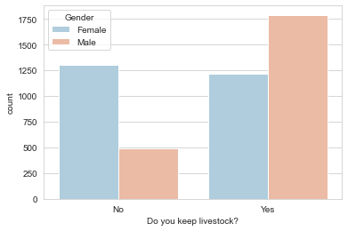
Graphs of number of farmers who keep livestock and gender composition of farmers who keep livestock.
More male farmers keep livestock than female farmers and vice versa.
Over 50% of the farmers keep livestock.
More 30% of the farmers do not keep livestock

Slide 28
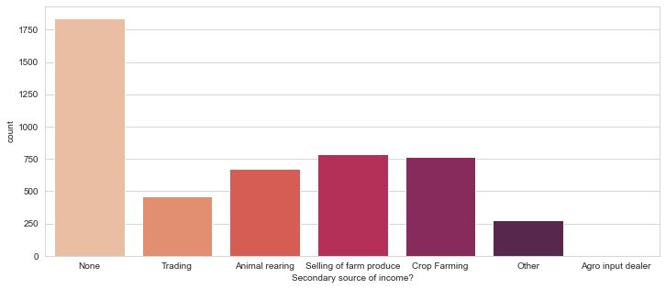
Graph of Secondary source of income
Ove1r 1750 of the f1armers no secondary source of income. The highest source of secondary income is Selling of farm produce ,followed by crop farming animal farming.

Slide 29
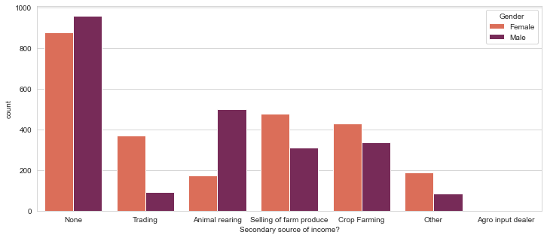
Graph of Gender composition of Secondary source of income respectively.
Gender composition of Secondary source of income. More male farmers rear animals as their secondary source of income. Female farmers engage in sell1i1n1g farm products, crop farming and trading as their secondary source of income more than the male farmers do

Slide 30
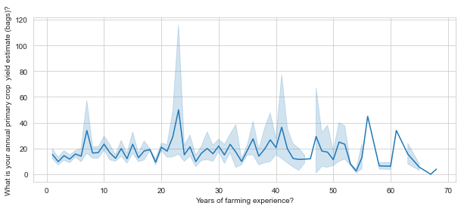
Findings
Graph of Years of farming experience compared with bags of annual crop yield estimate.
Farmers between the farming y1ears of 22 to 25 have the highest crop yield estimate

Slide 31
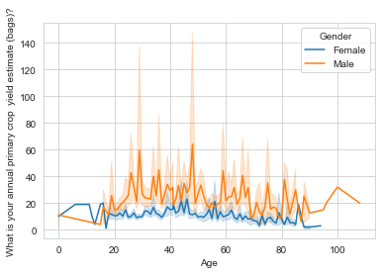
Findings
Graph of Age and annual primary crop yield estimates (bags) with respect to Gender
Male farmers yield more annual crop yield than female farmers

Slide 32
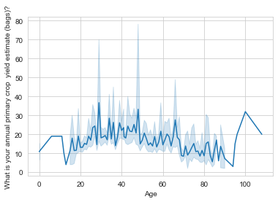
Graph of Age and annual primary crop yield estimate(bags)
Farmers between the ages 28 to 30 have highest annual primary crop yield estimate(bags) of about 38 bags .
Farmers nearing age 100 have the lowest annual primary crop yield estimate(bags)

Slide 33
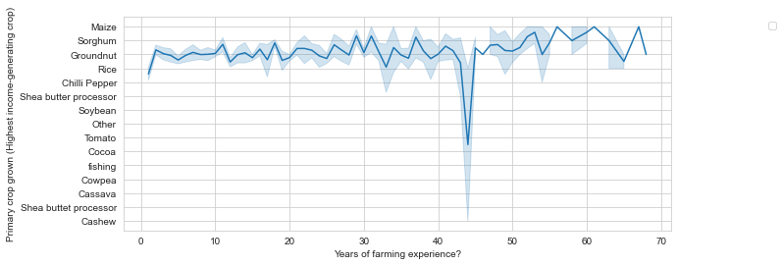
Graph of Years of farming experience and the primary crop grown(Highest income generating crop)
As the years of experience increases, the primary crop grown .
Farmers with 42 to46 years of experience have cocoa as the primary crop grown.
Farmers with 55 to602 years of experience have maize as the primary crop grown.

Slide 34
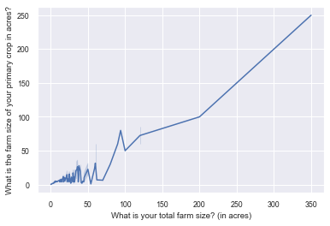
Findings
Graph of Total farm size and farm size of primary crop.
As the total farm size increases the farm size of primary crops also increases.

Slide 35
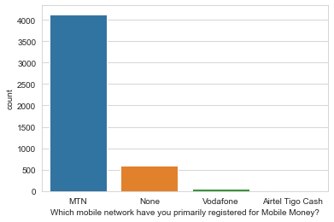
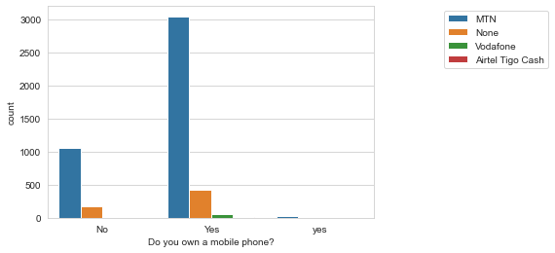
Findings
Most farmers have MTN as their mobile network primarily for Mobile money
Most of the farmers own phones and use MTN as their primarily registered network for Mobile Money , whilst a good number of farmers without phone also have MTN as their primary mobile network for mobile money

Slide 36
Additional findings
Maize is the highest secondary crop grown, followed by
Groundnut Rice, Soyabean and Chili Pepper respectively among others
Name of Farmer Group/ Association/ Agribusiness.
Gubkatimali group/association has the highest number of farmers in their group, followed by MS Bonsu Kpammaga and Suglo n bor buni respectively.

